Slide 1
CRIME IN US COMMUNITIES
TEAM 51 PROGRESS REPORT

Slide 2
TEAM MEMBERS
JENNY CHEN
JONATHAN CASCIOLI
MAKRAND KALYANKAR
MEIR WEINER
XIAOLU SU

Slide 3
OVERVIEW
The reduction of crime in US communities, especially violent crime, is something that every local government should prioritize. Our project explores the factors that most influence the rate of violent crime in order to help local governments allocate funding and enact policies to create the safer communities.

Slide 4
Planned approach
Data preparation
Seek multiple publicly-available data sources and join them on a primary key to clean, transform, and prepare for analysis.
Exploratory data analysis
Preliminary observations of response variable and key explanatory variables. Includes graphs & visualizations
modeling
Train at least 2 different types of models (split data into training and test sets to evaluate accuracy metrics)
reporting
Create presentation summarizing key findings and emphasizing business value

Slide 5
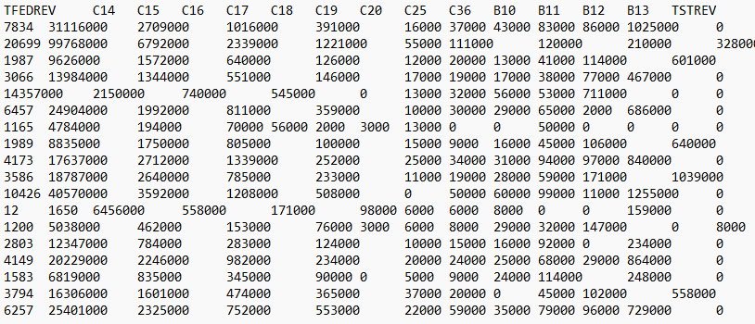
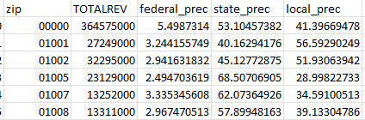
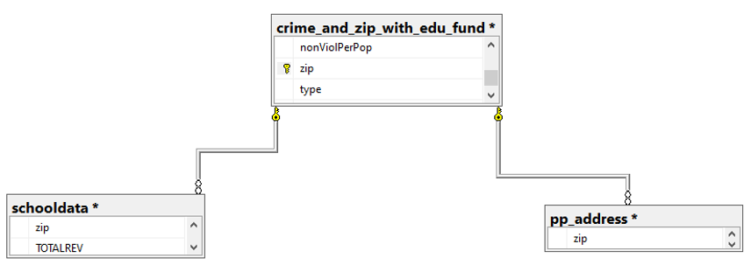
Data preparation
communityName
BerkeleyHeightstownship
Marpletownship
Tigardcity
Gloversvillecity
communityName | zip
berkeleyheights | 07922
marple | 19008
tigard | 97223
gloversville | 12078
Completed:
City and town names were cleaned and reforamtted to a useable form
crime data set was joined with a zipcode data set based on matching city/town names
School budget data set cleaned, proccesed, and joined with the crime data set based on matching zipcodes
Removed any duplicate rows originating from join condition, Normalized missing data to NULL values, and enforced data type conditions
Findings:
Signifinact time and effort is needed for data cleaning and processing
Starting with 200 features and 11,516 observations with lots of missing values we ended with 38 usable features and 1414 unique observations
Each unique observation representing a community in the crime data set

Slide 6
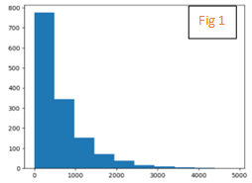
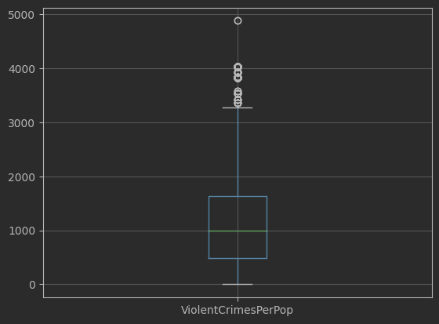
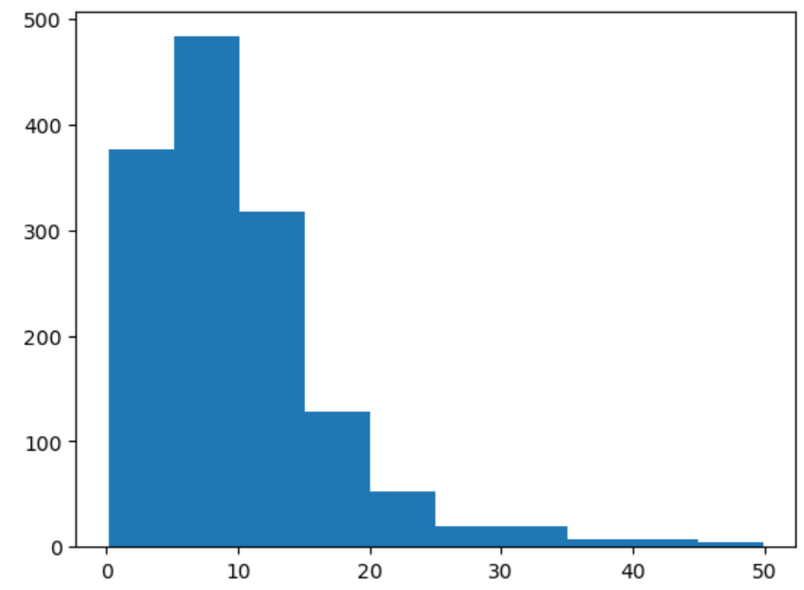
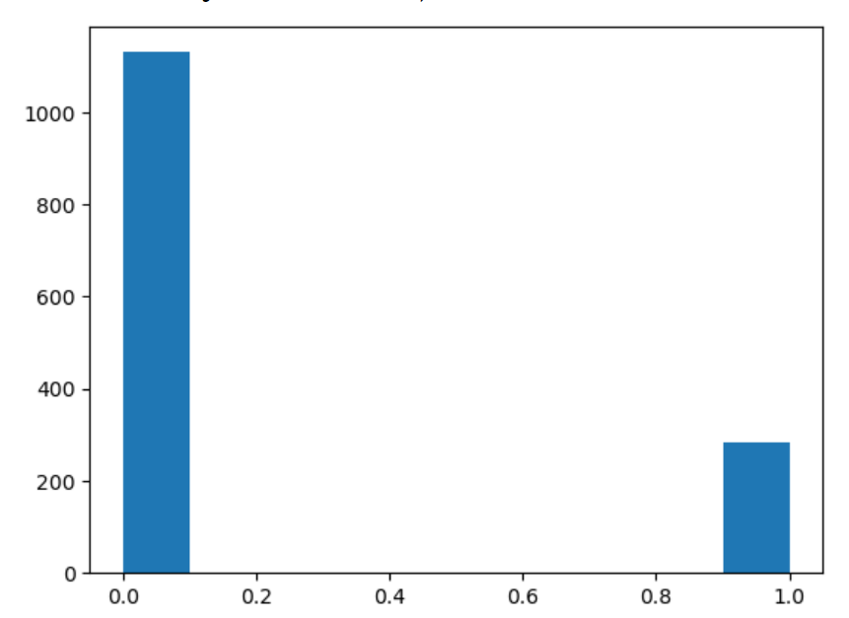
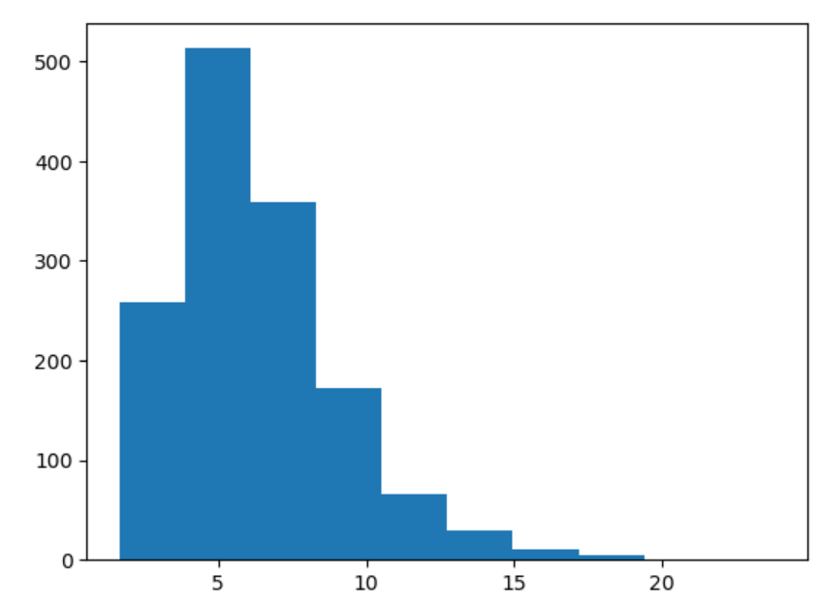
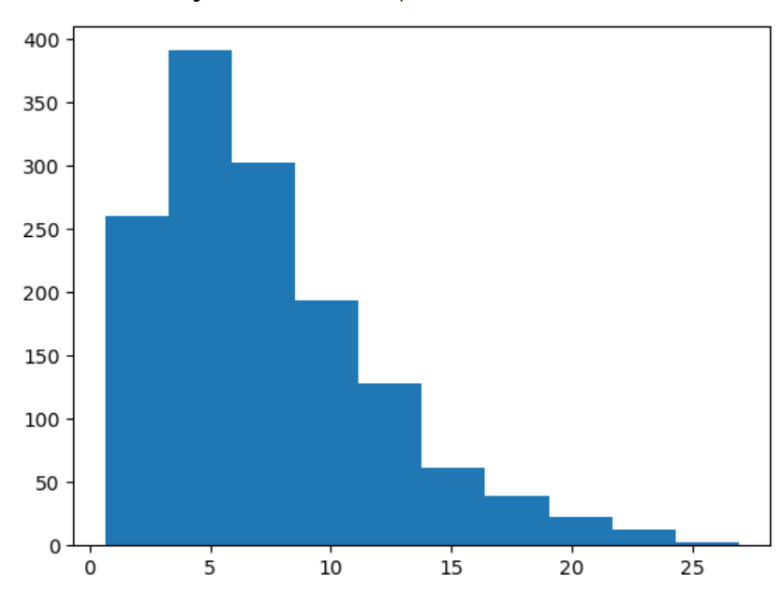
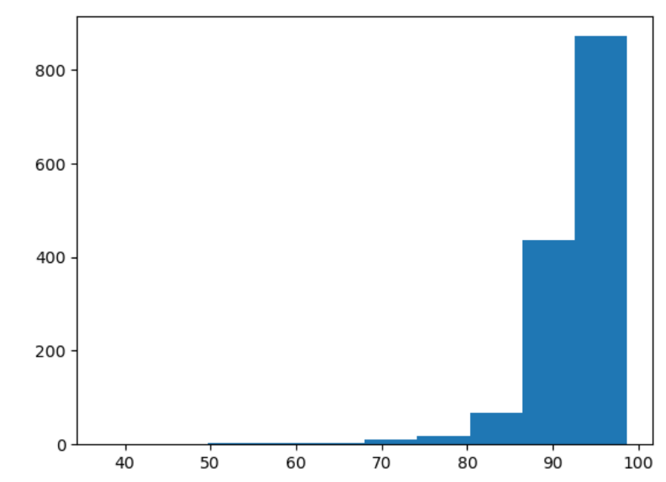
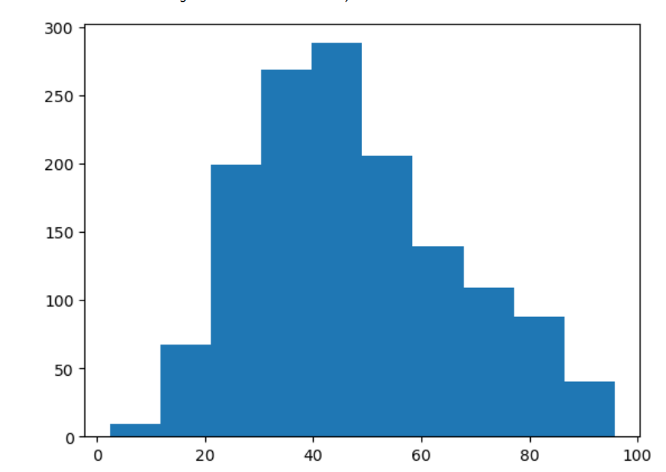
Exploratory data analysis
Violent Crimes per Population Unit
Response Variable
Histogram
Completed:
Cleaned and prepped data for production use
Looked at response variable
Looked at features we hypothesize to be most important
Histograms of Explanatory Variables
% with less than 9th Grade Education
Access to Planned Parenthood
% of population unemployed
Findings:
Crime rate variable is right-skewed suggesting that few communities have extremely high crime rates
Some of the explanatory variables seem to be correlated
% of homes non-vacant
% of population using public assistance
% of homes that are non-vacant
% of education funded by local government
Next steps
Potentially looking at ways we can remove autocorrelation, although this may not be as important if we don't choose a linear regression model

Slide 7
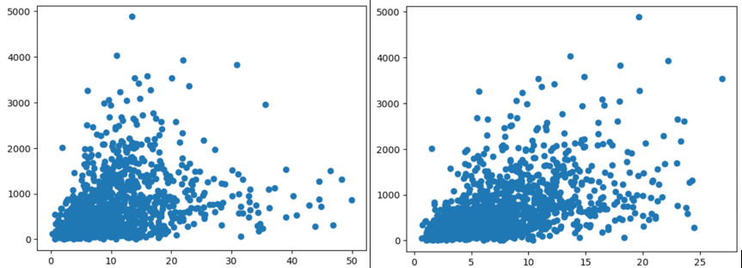
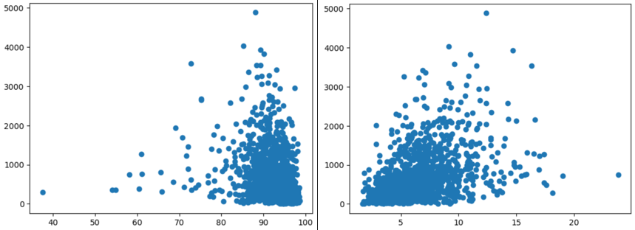
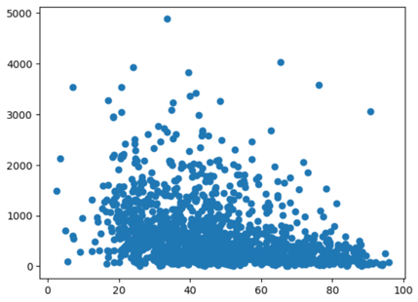
Exploratory data analysis
Scatter Plots of Explanatory Variables Vs Response Variable
Many of the features do not have linear or linear- transformable relationships with the response
Multi collinearity is an issue that would need to be addressed.
Multivariate regression model may not perform for this dataset.
% with less than 9th Grade Education
% of population unemployed
% of population using public assistance
% of homes that are non-vacant
% of education funded by local government

Slide 8
modeling
Next steps
Compare performances of multiple regression models to find the most significant features that affect violent crime rate:
Linear regression for a general diagnosis on all features
Greedy algorithm for a first stab at feature selection
Possibly LASSO and Elastic Net to reduce overfitting and improve predictability
Regression Tree, with hyperparameter optimization for an optimal model in terms of accuracy
Random Forest or XGBoost as alternative black-box approachs of regression trees to tradeoff interpretabilty for prediction accuracy
*note: we will split the data into training and testing sets before modeling

Slide 9
Research findings
The paper explains aggregate crime regressions and questions the effectiveness of capital punishment. Our project shares a similar perspective to aggregate the crime data at the county level to determine the most significant factors that reduce crimes most effectively. The paper might be subject to overlooking other variables other than capital punishment that could also affect crime occurrences, so our project will find improvement by focusing on feature selections (Durlauf, S).
The comparative study aims to increase crime classification accuracy by applying multiple classification algorithms to select features from the pre-processed crime dataset. The selected features in this study are similar to the ones we are targeting in our project. However, the study focuses on the performances of the models instead of the comparison of features. Our project will emphasize the comparison of features by their impact on crimes as a reference to help with the decision-making process of the government(Abdul Jalil, M).

Slide 10
references
Abdul Jalil, M. @, Mohd, F., & Mohamad Noor, N. M. (2017). A comparative study to evaluate filtering methods for crime data feature selection. Procedia Computer Science, 116, 113–120. https://doi.org/10.1016/j.procs.2017.10.018
Durlauf, S. N., Navarro, S., & Rivers, D. A. (2010). Understanding aggregate crime regressions. Journal of Econometrics, 158(2), 306–317. https://doi.org/10.1016/j.jeconom.2010.01.003
John J. Donohue, Steven D. Levitt, The Impact of Legalized Abortion on Crime over the Last Two Decades, American Law and Economics Review (2020) (earlier versions available as NBER Working Paper No. w25863 (2019) HERE and at SSRN.com (also 2019) HERE).
MARKOWITZ, F.E. (2006), PSYCHIATRIC HOSPITAL CAPACITY, HOMELESSNESS, AND CRIME AND ARREST RATES. Criminology, 44: 45-72. https://doi.org/10.1111/j.1745-9125.2006.00042.x
Hamid Noghanibehambari, School Finance Reforms and Juvenile Crime, American Law and Economics Review, Volume 24, Issue 1, Spring 2022, Pages 1–86, https://doi.org/10.1093/aler/ahac001
Stephen Machin, Olivier Marie, Sunčica Vujić, The Crime Reducing Effect of Education, The Economic Journal, Volume 121, Issue 552, May 2011, Pages 463–484, https://doi.org/10.1111/j.1468-0297.2011.02430.x

